Slide 1


SEO Case Studies
Brainmine Tech Vision:
Brainmine Tech expand your brand reach and maximum your ROI.

Slide 2
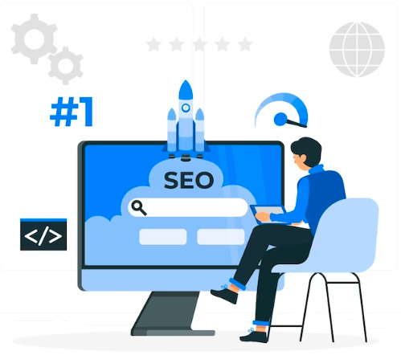
About Swarnavihar Old Age Home
Swarnavihar Old Age Homes - Search Engine Optimization
Case Study
About Our Client
Swarnavihar Old Age Homes, based in Pune, is an assisted living facility dedicated to supporting and caring for elderly individuals. Their mission revolves around providing compassionate, empathetic, and kind care to the elderly.

Slide 3

Importance of the SEO for the Website
SEO stands for Search Engine Optimization. In the simplest of terms, good SEO optimizes your visibility online. This means that the more people see your website, the more your online traffic increases, and the better your chances to provide your product or service to a greater number of people.
SEO has everything to do with quantity and quality. The better your website is on both the back and front ends, the better traffic you will get, and the more search engines will increase your search rankings. Building SEO works by combining SEO elements using a data-driven approach.
These factors include:
Keyword analysis
Backlink building
Content creation

Slide 4
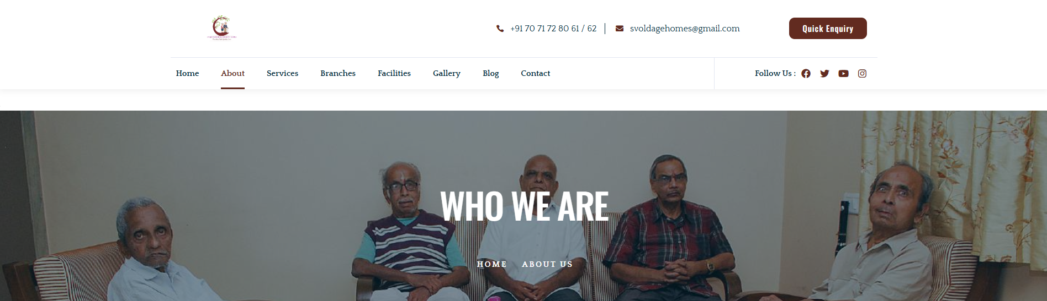
What was Swarnavihar Oldage Homes Looking for?
Increase organic traffic to the website.
Improve keyword rankings.
Generate more organic leads.

Slide 5



Problem Statement
Out of 19 targeted keywords, only 4 ranked on the first page, with limited progress over four months
Technical and content issues were causing poor indexing and crawlability of service pages.

Slide 6
What Brainmine Provide Swarnavihar Oldage Homes
Key Challenges
Sustainability and Growth
To Rank the website with high competition
Gaining leads in competition with traffic website
Working in niches that requires vast amounts of knowledge about highly technical topics
Finding RELEVANT BACKLINKS

Slide 7
Proposed Solution
Steps Taken:
Conducted an in-depth website technical audit.
Performed extensive competitor and keyword research.
Developed a comprehensive on-page and off-page SEO strategy.
Focused on content marketing to improve keyword rankings and traffic.
Resolved all technical issues using Google Search Console (GSC) and SEMrush.
Secured high-quality backlinks through off-page submissions on high Domain Authority (DA) websites.

Slide 8
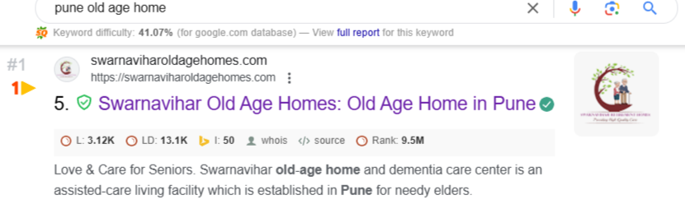
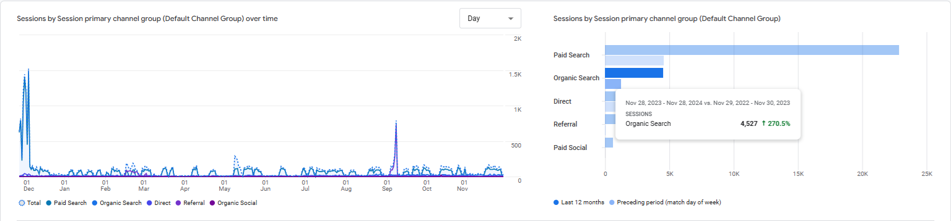
GA4 Result
Our main high competitive keywords are rank on the 1st page in Search Engine.
Our website traffic continuously has increased as compared with the previous year.
Organic Traffic is Increased by 270% is As compared to Last One Year

Slide 9
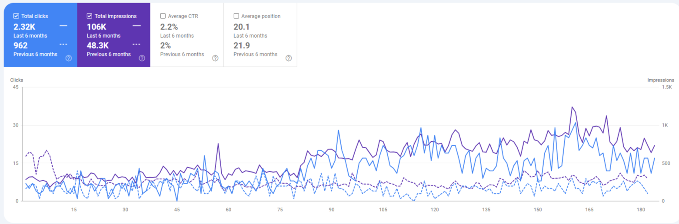
Search Console Result
Drastic improvement in clicks and impressions over the last six months.
Achieved a featured snippet for one of the blogs, boosting website credibility.

Slide 10
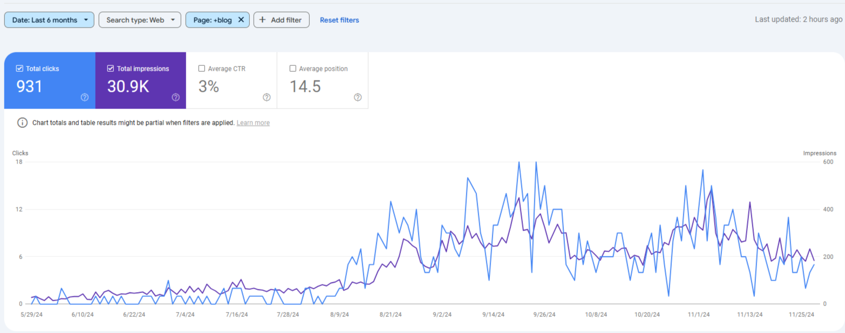
Search Console Result - Blog
This screenshot highlights the Google Search Console performance of blog metrics for the last six months, showing 931 total clicks, 30.9K impressions, a 3% average CTR, and an average position of 14.5.

Slide 11
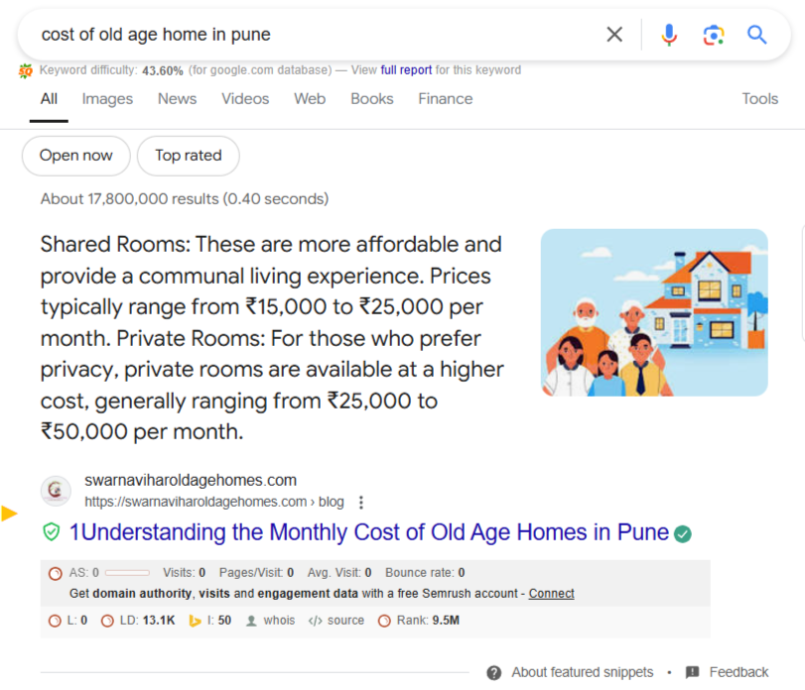
Featured Snippet Achievement
As we can see that we get a featured snippet for the blog which helps to increase the credibility of the website
Our Approach
We have done the strategy to interlink the blogs with each other

Slide 12
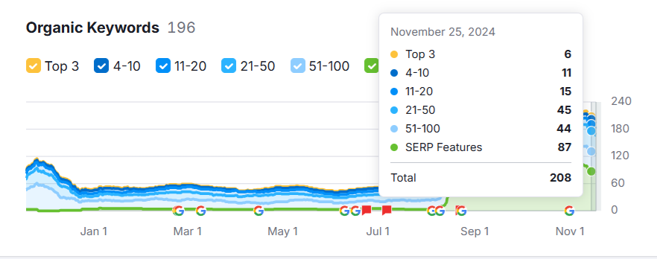
Achievement In Organic Keyword
Organic keyword rankings overview showing distribution across Top 3, 4-10, and other positions as of November, 2024

Slide 13
SEO Keyword Ranking
Best Performing Keywords
Top Ranked Keywords – Ranked on 1st Page
Keywords Those are on 1st page helped increasing traffic on the website. Also, off page submissions and backlinking strategy helped to improve ranking position for high potential keywords
pune old age home
old age homes pune
old age homes
old age home at pune
old age home in pune
post operative nursing care in pune
post operative care in pune
post operative care homes
dementia care in pune
dementia care homes in pune
paralysis care centre
paralysis care centre in pune
geriatric nursing care in pune
senior retirement homes
old age care centre
best old age home
dementia care homes
paralysis patient care centre
geriatric care services
retirement homes in pune
retirement homes pune
nursing homes in pune
best old age home in pune
senior citizen retirement homes in pune

Slide 14
THANK
YOU

